Slide 1
BAIL BONDS
ASSISTANT DISTRICT ATTORNEY JAVIN CRIPPS
15TH JUDICIAL DISTRICT

Slide 2
AGENDA
HISTORY OF BAIL BONDS
Non-Bail Offenses
WHERE TO START
TO ROR OR TO NOT ROR
FACTORS TO CONSIDER
Driving offenses Bond

Slide 3
BONDING HISTORY
Bail is a basic component of the American judicial system and is predicated on the principle “that a person accused of [a] crime shall not, until ... finally adjudged guilty in the court of last resort, be absolutely compelled to undergo imprisonment or punishment.” Hudson v. Parker, 156 U.S. 277, 285, 15 S.Ct. 450, 39 L.Ed. 424 (1895).
The Eighth Amendment to the United States Constitution prohibits imposing “[e]xcessive bail” or “excessive fines” and inflicting “cruel and unusual punishments.” U.S. Const. amend. VIII. Although this provision does not create a right to bail, United States v. Salerno, 481 U.S. 739, 754–55, 107 S.Ct. 2095, 95 L.Ed.2d 697 (1987), it mandates that when pretrial bail is set for a criminal defendant, the amount shall not be excessive.

Slide 4
HISTORY CONTINUED
The Tennessee Constitution guarantees that “all prisoners shall be bailable by sufficient sureties, unless for capital offenses, when the proof is evident, or the presumption great.” Tenn. Const. art. I, § 15. This constitutional provision grants a defendant the right to pretrial release on bail pending adjudication of criminal charges.
That excessive bail shall not be required, nor excessive fines imposed, nor cruel and unusual punishments inflicted.
However there are certain situations that a Defendant is not entitled to bail. Most of these are addressed by the Judge of the Court.

Slide 5
Non-Bail Offenses
Capital offenses (First Degree Murder, and Possibly Aggravated rape of a child)
Post-conviction
Failure to comply with conditions of a prior bail bond
Take into consideration when setting new bond on charges
Conviction in another jurisdiction
Violation of Probations

Slide 6
Where to start
TCA 40-11-115 ROR or unsecured bond factors to consider
FIRST CONSIDERATION
ENSURING THE SAFETY OF THE COMMUNITY
ENSURING THE APPEARANCE OF THE PERSON
Factors to consider
“Pretrial risk assessment” any jurisdiction operate with this?
https://www.youtube.com/shorts/KO1DA2G3_0k
https://www.youtube.com/watch?v=s3QVJ0yVv-I

Slide 7
Factors and Conditions to Consider ROR
Length of residence in Community
Employment Status
Prior criminal record, including prior releases on recognizance or bail
Was defendant on bond for another offense
Nature of offense – safety of the community
Substance use or mental health issues
Any other factors related to community or defendant’s willful FTA

Slide 8
What offenses cannot have an ROR
Class A felony
Class B Felony
Agg Assault
Agg assault against a law enforcement or first responder
Felony Domestic Assault
Agg Assault or Domestic Assault that involves strangulation

Slide 9
TCA 40-11-116 Conditions of Release
If a magistrate determines that conditions of release are necessary, then the magistrate must impose the least onerous conditions reasonably likely to ensure the safety of the community and the Defendant’s appearance in court.
The magistrate may impose 1 or more conditions:
A supervisor of the defendant
Restrict the movements, activities, associations and/or residences of the Defendant
Any other reasonable restrictions for the safety of the community and D’s Appearance

Slide 10
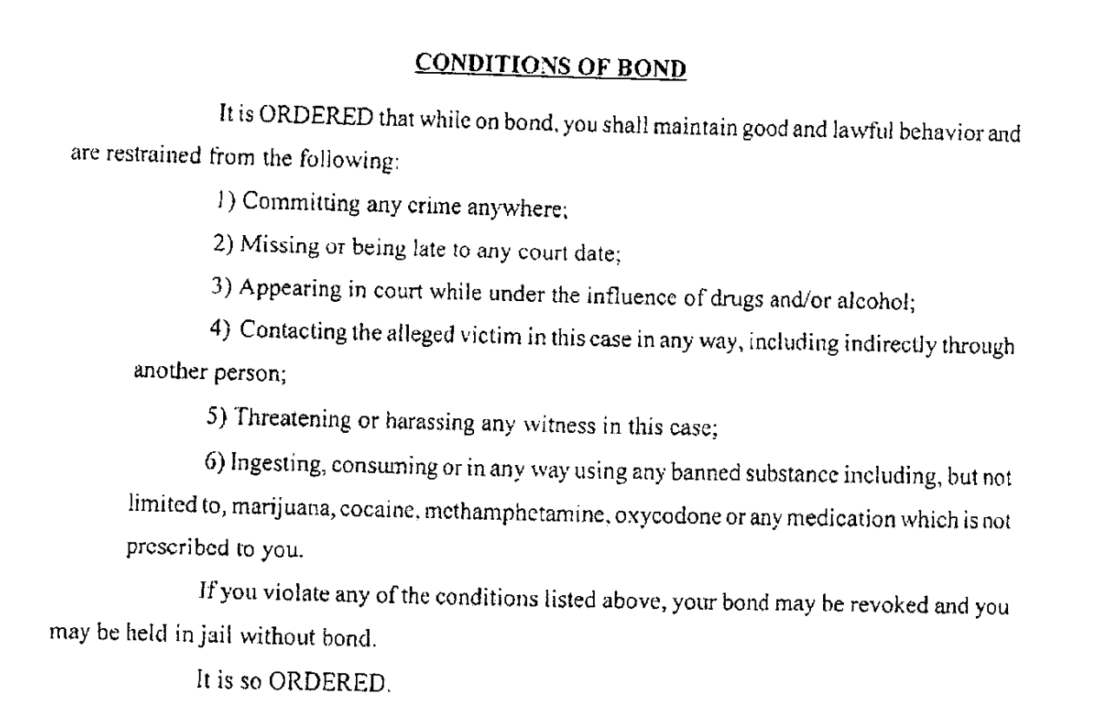

Slide 11
TCA 40-11-116 Crimes that require Judge approval before supervised release (b)(1)
Class A Felony
Class B Felony
Agg Assault
Agg assault against law enforcement or first responder
Domestic Assault (Felony)
If Magistrate imposes conditions on A, B, C, or D felony and pretrial services are available within the county, then the court SHALL require the D to participate in pretrial monitoring.

Slide 12
TCA 40-11-117
If the magistrate determines that a release on Recognizance or with conditions will not reasonably ensure the safety of the community and the appearance of the D as required, the Magistrate MUST require bail to be given.

Slide 13
TCA 40-11-118 Bail Amount determination
Bail must be set as low as the court determines is necessary to ensure the safety of the community and the appearance of the Defendant
Considerations in bond: Bond Factors
Length of residence in the community.
Employment status, history and financial condition, but ability to pay is not to be considered.
Defendant’s reputation, character and mental condition
Prior Criminal record

Slide 14
TCA 40-11-118 Factors considered
Failure to Appear’s
Evading arrests
Nature of the offense and probability of conviction
Likely Sentence
Prior criminal record and likelihood that defendant poses a risk of danger to the community
Responsible community members that vouch for the Defendant
Any other factors indicating the D’s ties to the community or bearing on the risk of willful failure to appear
Including whether the D is lawfully present in the state

Slide 15
DUI Conditions
DUI, Vehicular Assault, Aggravated Vehicular Assault, Vehicular Homicide or Agg vehicular homicide
SHALL require the Defendant to operate equipped with an ignition interlock if there was alcohol:
Collision involving property damage
Minor present
Suspended license for DUI
Prior conviction for
DUI Reckless Driving Reckless endangerment
Vehicular Assault Agg VA
Vehicular Homicide Agg VH

Slide 16
DUI Conditions Continued
If you find no ignition interlock, must make findings on why the requirement would not be in the best interest of justice and safety
Vehicular Assault; Vehicular Homicide, Agg VH and has a prior alcohol related conviction, Transdermal monitoring device shall be a condition of the person’s Bail
3rd or subsequent DUI and new one has Alcohol, transdermal device to be ordered.

Slide 17
Scenario 1
Defendant lives in Michigan, Stopped in your county and has several drugs, scales, and baggies. Appears to be fentanyl, meth, and heroin. Weight on the Fentanyl is 700 grams, meth is 350 grams, and heroin is 180 grams. No FTA’s, but no ties to the community.
Do you ask officers for a criminal history?
Do you inquire of the D where he lives?
Employment History? Risk to the community?

Slide 18
Scenario 2
D travelling through county, arrested for DUI. On bond for prior DUI. Has a prior conviction for DUI in 2010.
What questions do you ask?
What restrictions?
What conditions?
What do you want to hear from the officer or the D?

Slide 19
Scenario 3
22 year old arrested for Violations of conditional release.
He violated the condition by being around the victim of the domestic assault.
He promises to not go around her again.
Appropriate bond?
Appropriate Questions to ask?

