Slide 1
Search Warrants
What Goes In, What Stays Out,
and What Will Hold Up in Court?
JCAT Summer Conference
July 31, 2023
Scott Kimberly
Attorney at Law
scott@murfreesborolawyer.com
WWW.MURFREESBOROLAWYER.COM

Slide 2
Search Warrants
What Goes In, What Stays Out,
and What Will Hold Up in Court?
What This Presentation CAN DO
What This Presentation CANNOT DO
WWW.MURFREESBOROLAWYER.COM

Slide 3
Search Warrants
What Goes In, What Stays Out,
and What Holds Up in Court?
Presentation Overview
Legal Requirements
The Courts Get Involved
“Probable Cause”
Common Issues
WWW.MURFREESBOROLAWYER.COM

Slide 4
Search Warrants
Legal Background
United States Constitution
Fourth Amendment
“The right of the people to be secure in their persons, houses, papers, and effects, against unreasonable searches and seizures, will not be violated, and no warrants will issue, but upon probable cause, supported by oath or affirmation, and particularly describing the place to be searched, and the persons or things to be seized.”
Key Points: Probable Cause
Supported by Oath
Particular Description
WWW.MURFREESBOROLAWYER.COM

Slide 5
Search Warrants
Legal Background
Tennessee State Constitution
Article I, Section VII
“[P]eople shall be secure in their persons, houses, papers and possessions, from unreasonable searches and seizures; and that general warrants, whereby an officer may be commanded to search suspected places, without evidence of the fact committed, or to seize any person or persons not named, whose offenses are not particularly described and supported by evidence, are dangerous to liberty and not to be granted.”
Key Points: “…without evidence of the fact…”
“Particularly described…”
“… supported by evidence.”
WWW.MURFREESBOROLAWYER.COM

Slide 6
Search Warrants
Legal Background
T.C.A. 40-6-103
Probable Cause and Affidavit.
A search warrant can only be issued on probable cause, supported by affidavit, naming or describing the person, and particularly describing the property, and the place to be searched.
Key Points: Probable Cause
Supported by Affidavit
“… particularly describing…”
WWW.MURFREESBOROLAWYER.COM

Slide 7
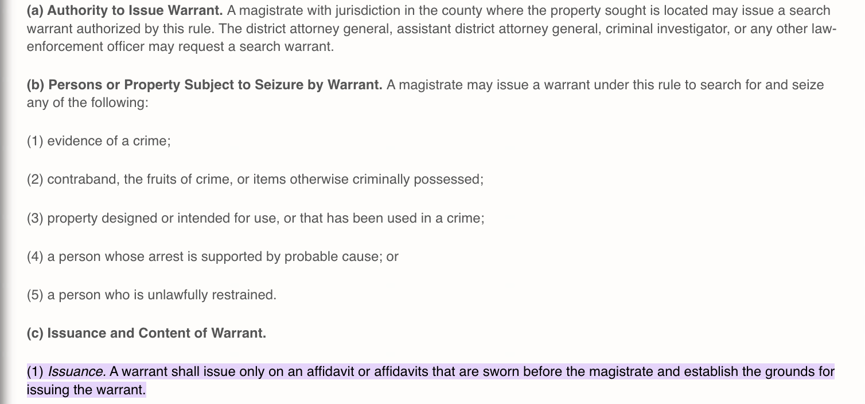
Search Warrants
Legal Background
Rule 41
Tennessee Rules of Civil Procedure

Slide 8
Search Warrants
Legal Background
What We Know
To issue a search warrant, the law requires:
A magistrate in the county of the offense…
… determines that probable cause exists…
… supported by sworn affidavit…
… that provides sufficient particularity of that person, place, or thing to be searched.

Slide 9
Search Warrants
Judicial Review
Let’s See How the Courts Mess It Up
A written and sworn affidavit... is an indispensable prerequisite to the issuance of a search warrant in the State of Tennessee. (State ex. rel. Blackburn v. Fox, 1956)
Further, the affidavit must be sworn before a neutral and detached magistrate. (State v. Stevens, 1999)
A search warrant shall be issued only on the basis of an affidavit, sworn before a neutral and detached magistrate, which establishes probable cause of its issuance. (State v. Stevens, 1999)
The probable cause determination of a neutral and detached magistrate is "entitled to great deference by a reviewing court. (State v. Jacumin, 1989)
WWW.MURFREESBOROLAWYER.COM

Slide 10
Search Warrants
Judicial Review
Let’s See How the Courts Mess It Up
To establish probable cause, the affidavit must show a nexus among the criminal activity, the place to be searched, and the items to be seized. (State v. Saine, 2009)
The nexus between the place to be searched and the items to be seized may be established by the type of crime, the nature of the items, and the normal inferences where a criminal would hide the evidence. (State v. Smith, 1993)
But Don’t Worry! If the affidavit doesn’t include direct evidence of such a nexus, appellate courts may determine whether it was reasonable for the magistrate to infer that the items of contraband listed in the affidavit would be located in the place to be searched. (State v. Saine, 2009) In other words, reasonable inferences are allowed!
WWW.MURFREESBOROLAWYER.COM

Slide 11
Search Warrants
Probable Cause
According to the Courts, Probable Cause…
“… is more than a mere suspicion but less than absolute certainty.”
“… is a ‘practical, nontechnical conception.’”
“…deal[s] with probabilities. These are not technical; they are the factual and practical considerations of everyday life on which reasonable and prudent men, not legal technicians, act.”
“… is a fluid concept — turning on the assessment of probabilities in particular factual contexts — not readily, or even usefully, reduced to a neat set of legal rules.”
“... according to its usual acceptation, means less than evidence which would justify condemnation. It imports a seizure made under circumstances which warrant suspicion.”
WWW.MURFREESBOROLAWYER.COM

Slide 12
Search Warrants
Probable Cause
Justice Rehnquist Said It Best:
“Articulating precisely what ‘reasonable suspicion’… mean[s] is not possible.”
WWW.MURFREESBOROLAWYER.COM

Slide 13
Search Warrants
Probable Cause
So What Is Probable Cause?
“[S]earch and arrest warrants long have been issued by persons who are neither lawyers nor judges, and who certainly do not remain abreast of each judicial refinement of the nature of ‘probable cause’…
…probable cause deals ‘with probabilities. These are not technical; they are the factual and practical considerations of everyday life on which reasonable and prudent men, not legal technicians, act.’”
Illinois v. Gates
United States Supreme Court, 1983
What Would Justice Potter Say?
WWW.MURFREESBOROLAWYER.COM

Slide 14
Search Warrants
Common Challenges
Reliable Hearsay in General
General Rule: An affidavit may include reliable hearsay information as a basis to establish probable cause. (State v. Henning, 1998)
Presumption of Reliability. Information from law enforcement and citizen informants are presumed reliable.
Criminal Informants. Ever-changing legal history to determine admissibility in court.
WWW.MURFREESBOROLAWYER.COM

Slide 15
Search Warrants
Common Challenges
Reliable Hearsay for Informants
Aguilar/Spinelli (SCOTUS, 1960s): If an Affiant relies upon hearsay information from a criminal informant, the magistrate must satisfy basis of knowledge and veracity- a two-prong test.
"Affiants have received reliable information from a credible person and do believe that heroin, marijuana, barbiturates and other narcotics and narcotic paraphernalia are being kept at the above described premises for the purpose of sale and use contrary to the provisions of the law.”
WWW.MURFREESBOROLAWYER.COM

Slide 16
Search Warrants
Common Challenges
Reliable Hearsay for Informants
Illinois v. Gates (SCOTUS, 1983): Abandons two-prong Aguilar/Spinelli Test, Adopts “Totality of Circumstances.”
On May 3, 1978, the Bloomingdale Police Department received by mail an anonymous handwritten letter which read as follows:
:
"This letter is to inform you that you have a couple in your town who strictly make their living on selling drugs….
SCOTUS: The Illinois court, alluding to an elaborate set of legal rules that have developed among various lower courts to enforce the “two-pronged test,” found that the test had not been satisfied.
WWW.MURFREESBOROLAWYER.COM

Slide 17
Search Warrants
Common Challenges
Reliable Hearsay for Informants
State v. Jacumin (Tenn., 1989): Explicitly declines to adopt Gates. Tennessee Law remains Aguilar/Spinelli Test.
The record shows that a search warrant was issued at 11:35 p.m. on July 14, 1985, authorizing officers of the Metropolitan Police Department to search the dwelling at 3410 Tisdale Avenue, the brown mailbox in front of the residence, and a 1984 red Nissan automobile bearing Tennessee license number 14-15U1. The inventory of property seized in the search is dated July 15, 1985, with a time of 7:00 p.m. and shows the seizure of marijuana, white powder (which tested positively for cocaine), various items of drug paraphernalia and a Smith & Wesson, .38, with six bullets. The officers' return was signed July 15, 1985.
WWW.MURFREESBOROLAWYER.COM

Slide 18
Search Warrants
Common Challenges
Reliable Hearsay for Informants
State v. Tuttle (Tenn., 2017): Abandons Aguilar/Spinelli Test for Gates “Totality of Circumstances” Approach.
A majority of the Court of Criminal Appeals reversed and concluded that the search warrant affidavit failed to establish a sufficient nexus between the defendant's residence and criminal activity, failed to establish the basis of knowledge and credibility of the information provided by Mr. Davis, an informant from the criminal milieu, and contained recklessly made false statements essential to establishing probable cause.
WWW.MURFREESBOROLAWYER.COM

Slide 19
Search Warrants
Common Challenges
Reliable Hearsay
State v. Tuttle (Tenn. 2017)
The informant's basis of knowledge and veracity or credibility remain highly relevant considerations. Rather than separate and independent considerations, they should now be understood simply as closely intertwined issues that may usefully illuminate the commonsense, practical question whether there is “probable cause” to believe that contraband or evidence is located in a particular place… Thus, we will apply the Gates test to determine whether the affidavit sufficiently established probable cause for issuance of the warrant.
WWW.MURFREESBOROLAWYER.COM

Slide 20
Search Warrants
Common Challenges
Particularity
United States Constitution: “… particularly describing the place to be searched, and the persons or things to be seized.”
T.C.A. § 40-6-103: “… particularly describing the property, and the place to be searched.”
WWW.MURFREESBOROLAWYER.COM

Slide 21
Search Warrants
Common Challenges
Particularity
Tennessee Supreme Court
“The requirement of particular description of the place to be searched is met by a description which particularly points to a definitely ascertainable place so as to exclude all others, and enables the officer to locate the place to be searched with reasonable certainty without leaving it to his discretion.” (Hatchett v. State, 1961)
“The test is whether, or not, the description will enable an officer to locate the place to be searched with reasonable certainty.” (State v. Smith, 1993)
Remember to Use Common Sense!
WWW.MURFREESBOROLAWYER.COM

Slide 22
Search Warrants
Common Challenges
Particularity
Particular, But No Explicit Time Requirement!
“This Court, however, has found no constitutional or statutory rule stating that an indispensable prerequisite to a valid affidavit is that the affidavit must contain a date or “time element”… Additionally, the General Assembly has expressly defined the components to be included in an affidavit… Also, Rule 41 of the Tennessee Rules of Criminal Procedure does not state that a date or time element must be included in an affidavit in support of a search warrant... Nothing in those definitions or explanations suggest that a specific date is an essential component of an affidavit.” State v. Joseph (Tenn., 2012)
WWW.MURFREESBOROLAWYER.COM

Slide 23
Search Warrants
Common Challenges
Particularity
But Including No Particular Time May Affect Staleness…
“We note that the certified question in this case does not encompass the issue of whether the information contained in the affidavit was stale; therefore, any argument to that effect is not properly before this Court for review.” State v. Joseph (Tenn., 2012)
WWW.MURFREESBOROLAWYER.COM

Slide 24
Search Warrants
Common Challenges
Particularity
Conclusory Allegations Are Insufficient
“The need for the magistrate to make a neutral and detached decision regarding the existence of probable cause requires that the affidavit contain more than mere conclusory allegations by the affiant.” (State v. Moon, Tenn. Crim. App. 1992)
“Recital of some of the underlying circumstances in the affidavit is essential if the magistrate is to perform his detached function and not serve merely as a rubber stamp for the police.”
(United States v. Ventresca, 1965)
WWW.MURFREESBOROLAWYER.COM

Slide 25
Search Warrants
Common Challenges
Lack of Independent Judgment
State v. Meeks (Tenn. Crim. App., 1993)
Franklin County, Tennessee
“… the defendant contends that the issuing magistrate was not neutral.”
“… the defendant contends that [the magistrate] did not make an independent determination of probable cause, but merely ‘rubber stamped’ [the Officer’s] affidavit. The defendant points out that [the magistrate] did not read every word in the affidavit, did not question [the Officer] about its contents, and failed to define probable cause in a suppression hearing.”
WWW.MURFREESBOROLAWYER.COM

Slide 26
Search Warrants
Common Challenges
Lack of Independent Judgment
State v. Meeks (Tenn. Crim. App., 1993)
Franklin County, Tennessee
“While an issuing magistrate cannot be said to have made an independent determination of probable cause without reading the affidavit at all, the defendant fails to provide us with anything that indicates a word-for-word reading is absolutely required. We therefore find that if a scanning overview of the affidavit raises probable cause in the mind of the magistrate, it is sufficient... She later testified that she would not sign a blank warrant, nor one she had not read, simply because the officer had sworn that the information it contained was true. Taken as a whole, this indicates sufficient knowledge of the contents of the affidavit to make an independent judgment on the issue of probable cause.”
WWW.MURFREESBOROLAWYER.COM

Slide 27
Search Warrants
Common Challenges
Lack of Independent Judgment
State v. Meeks (Tenn. Crim. App., 1993)
Franklin County, Tennessee
“We recognize, as did the trial court, that Commissioner Brewer did not ably articulate the scope and requirements of her job, nor did she use the best possible method in evaluating the affidavit. We nevertheless find that Commissioner Brewer was "neutral and detached" as required by law.”
“Although this issue has merit, we nevertheless disagree that reversible error was committed.”
WWW.MURFREESBOROLAWYER.COM

Slide 28
Search Warrants
What Goes In, What Stays Out,
and What Will Hold Up in Court?
THE END!
Scott Kimberly
Attorney at Law
scott@murfreesborolawyer.com
WWW.MURFREESBOROLAWYER.COM

Slide 29
Setting Bail: The Policy
Bail is a basic component of the American judicial system and is predicated on the principle "that a person accused of [a] crime shall not, until . . . finally adjudged guilty in the court of last resort, be absolutely compelled to undergo imprisonment or punishment.” - U.S. Supreme Court, 1895
U.S. Constitution – 8th Amendment
The Eighth Amendment to the United States Constitution prohibits imposing “[e]xcessive bail” or “excessive fines" and inflicting "cruel and unusual punishments.” Notice there is no right to bail!
Tennessee Constitution – Art. I, § 15
In contrast, the Tennessee Constitution guarantees that “all prisoners shall be bailable by sufficient sureties, unless for capital offen[s]es, when the proof is evident, or the presumption great.” Right to bail!
Tennessee Policy – T.C.A. § 40-11-118(b)
In determining the amount of bail necessary to reasonably assure the appearance of the defendant while at the same time protecting the safety of the public, the magistrate shall consider the following…
WWW.MURFREESBOROLAWYER.COM

Slide 30
Bail Bonds
T.C.A. § 40-11-102
Bailable Offenses
Before trial, all defendants shall be bailable by sufficient sureties, except for capital offenses where the proof is evident or the presumption great.
WWW.MURFREESBOROLAWYER.COM

Slide 31
Bail Bonds
T.C.A. § 40-11-115(a)
Release on Recognizance or Unsecured Bond
Any person charged with a bailable offense may, before a magistrate authorized to admit the person to bail, be ordered released pending trial on the person's personal recognizance or upon the execution of an unsecured appearance bond in an amount specified by the magistrate.
If the magistrate orders that the person be released pending trial, then the magistrate shall impose the least restrictive conditions of release that will reasonably ensure the appearance of the person as required and the safety of the community.
2021 Amendment
WWW.MURFREESBOROLAWYER.COM

Slide 32
Bail Bonds
T.C.A. § 40-11-115(b)
Release on Recognizance or Unsecured Bond
In determining under subsection (a) whether or not a defendant shall be released, and if so, the least restrictive conditions of release that will reasonably ensure the appearance of the defendant as required and the safety of the community, the magistrate must consider any available results of a validated pretrial risk assessment conducted regarding the defendant for use in the jurisdiction and the defendant's financial resources. In making this determination, the magistrate may also consider: …
2021 Amendment
WWW.MURFREESBOROLAWYER.COM

Slide 33
Bail Bonds
T.C.A. § 40-11-115(b)
Release on Recognizance or Unsecured Bond
2021 Amendment Added
2021 Amendment Removed
Whether Defendant was on release for another offense
Substance use or mental health issues
Mandatory Review of Pretrial Risk Assessment
Mandatory Review of Financial Resources
Employment History
Family Ties & Relationships
Reputation, Character, and Mental Condition
Responsible Community Members Who Will Vouch

Slide 34
Bail Bonds
T.C.A. § 40-11-118(b)
Factors Considered in Setting Bail
In determining the amount of bail necessary to reasonably assure the appearance of the defendant while at the same time protecting the safety of the public, the magistrate shall consider the following:
Length of residence in the community
Reputation, character and mental condition
Employment status and history and financial condition
Nature of the offense and probability of conviction
Prior criminal record, record of appearance at court proceedings, record of flight to avoid prosecution or failure to appear at court proceedings
Prior criminal record and risk of danger to the community
Responsible community members who will vouch for reliability (Max Two!)
Family ties and relationships
Any Other Factors re: Ties to Community and FTA Risk

Slide 35
Setting Bail: The Factors
T.C.A. § 40-11-118(b)(1)
Length of Residence in the Community
WWW.MURFREESBOROLAWYER.COM

Slide 36
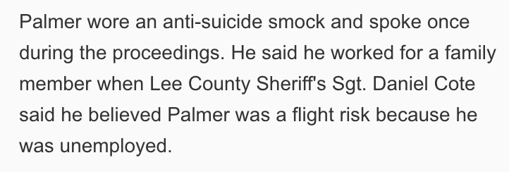
Setting Bail: The Factors
T.C.A. § 40-11-118(b)(2)
Employment Status / Financial Condition
WWW.MURFREESBOROLAWYER.COM

Slide 37
Setting Bail: The Factors
T.C.A. § 40-11-118(b)(3)
Family Ties / Relationships
WWW.MURFREESBOROLAWYER.COM

Slide 38
Setting Bail: The Factors
T.C.A. § 40-11-118(b)(5)
Prior Criminal Record (Risk of Flight)
WWW.MURFREESBOROLAWYER.COM

Slide 39
Setting Bail: The Factors
T.C.A. § 40-11-118(b)(6)
Nature of Offense / Likelihood of Conviction
WWW.MURFREESBOROLAWYER.COM

Slide 40
Setting Bail: The Factors
T.C.A. § 40-11-118(b)(6)
Nature of Offense / Likelihood of Conviction
WWW.MURFREESBOROLAWYER.COM

Slide 41
Setting Bail: The Factors
T.C.A. § 40-11-118(b)(7)
Prior Criminal Record (Risk of Danger)

Slide 42
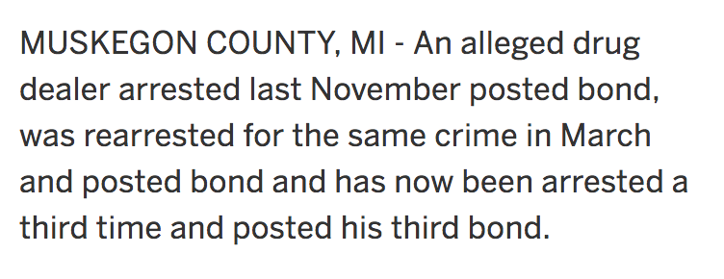
Setting Bail: The Factors
T.C.A. § 40-11-118(b)(7)
Prior Criminal Record (Risk of Danger)

Slide 43
Setting Bail: The Factors
T.C.A. § 40-11-118(b)(7)
Prior Criminal Record (Risk of Danger)

Slide 44
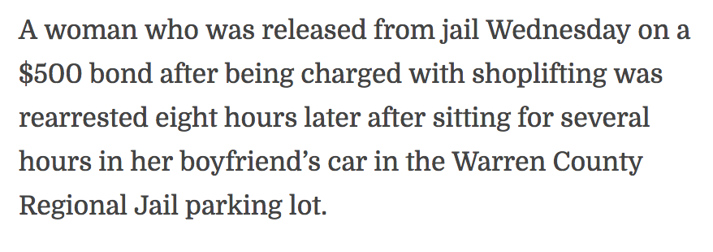
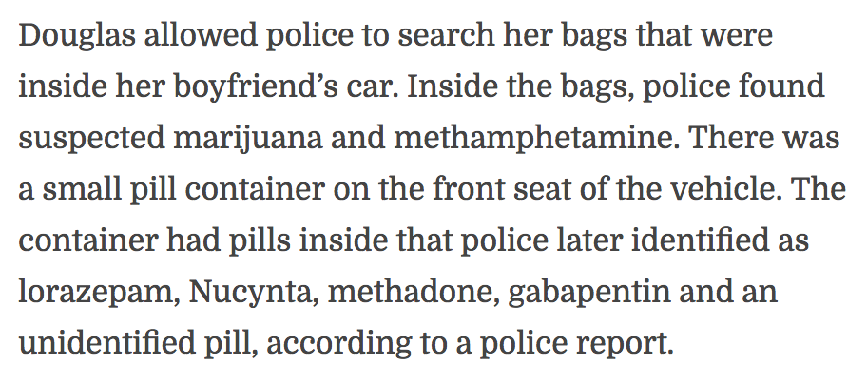
Setting Bail: The Factors
T.C.A. § 40-11-118(b)(7)
Prior Criminal Record (Risk of Danger)

Slide 45
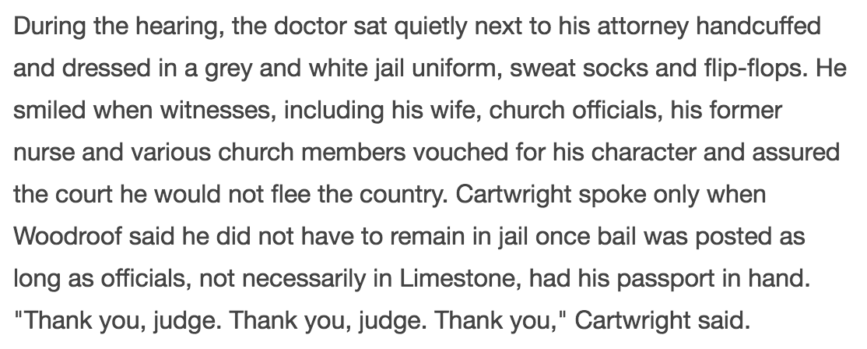
Setting Bail: The Factors
T.C.A. § 40-11-118(b)(8)
Community Members Vouching for Credibility
WWW.MURFREESBOROLAWYER.COM

Slide 46
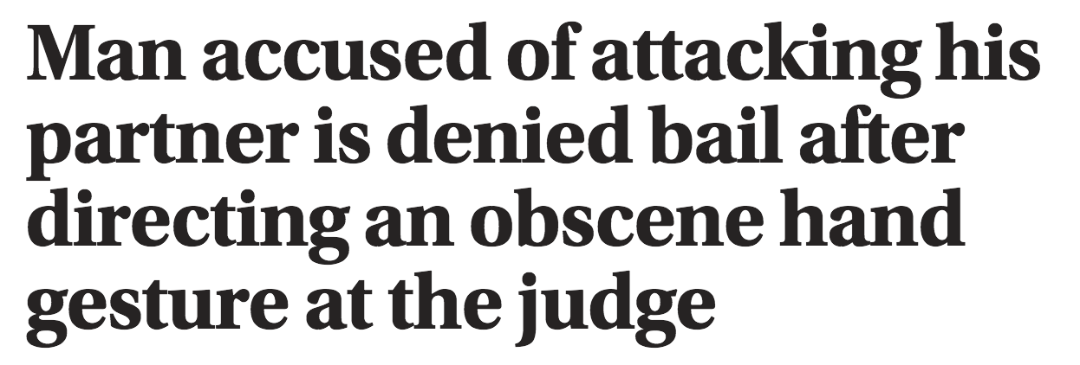
Setting Bail: The Factors
T.C.A. § 40-11-118(b)(9)
Other Factors: Ties to Community / FTA
WWW.MURFREESBOROLAWYER.COM

Slide 47
Judicial Commissioners Conference
THE END
Questions?
Scott Kimberly
Attorney at Law
scott@murfreesborolawyer.com
WWW.MURFREESBOROLAWYER.COM

