Slide 1

Domestic Violence law
What does it really mean?
By Donnie Harville, Esq.

Slide 2
Answer these questions.
National Coalition Against Domestic Violence
How many Tennesseans were murdered in domestic violence incidents in 2020?
Firearms were used in approximately ______% of these homicides?
In the United States, more than ______ adults experience domestic violence annually.
On a typical day, domestic violence hotlines nationwide receive over _____ calls.
Domestic abuse victim" means any person who falls within the six following categories :
1 in ____ women and 1 in ____ men have experienced stalking by an intimate partner during their lifetime

Slide 3
Answer these questions….
Tennessee law enforcement responded to __________reports of domestic violence in 2020
In 2020, _________ domestic violence abductions were reported by Tennessee law enforcement.
Between 2009 and 2017, there were ________ domestic violence murders in Tennessee.
Female victims sustain injuries _______x more often than male victims.
_______ million women and ________ million men in the United States have been stalked.

Slide 4
What is Domestic violence?
Domestic violence is the willful intimidation, physical assault, battery, sexual assault, and/or other abusive behavior as part of a systematic pattern of power and control perpetrated by one intimate partner against another. It includes physical violence, sexual violence, threats, economic, and emotional/psychological abuse. The frequency and severity of domestic violence varies dramatically.
Victims of intimate partner violence are at increased risk of contracting HIV or other STI’s due to forced intercourse and/or prolonged exposure to stress. Intimate partner victimization is correlated with a higher rate of depression and suicidal behavior. Only 34% of people who are injured by intimate partners receive medical care for their injuries.

Slide 5
Tennessee Domestic Violence Statistics
39.6% of Tennessee women and 36.8% of Tennessee men experience intimate partner physical violence, intimate partner rape and/or intimate partner stalking in their lifetimes.
90 Tennesseans were murdered in domestic violence incidents in 2020.
Firearms were used in approximately 60% of these homicides
Tennessee law enforcement responded to 69,385 reports of domestic violence in 2020.
In 2020, 1,420 domestic violence abductions were reported by Tennessee law enforcement.

Slide 6
Tennessee Domestic Violence Statistics
In 2020, intimate partners committed 613 forcible rapes that were reported to law enforcement.
On one day in 2020, 91% of the domestic violence service providers in Tennessee served 1,157 victims of domestic violence and received 259 hotline calls. Seventy-one requests for services went unmet due to lack of resources.
Between 2009 and 2017, there were 836 domestic violence murders in Tennessee.

Slide 7
USA Domestic Violence Statistics
In the United States, more than 10 million adults experience domestic violence annually.
If each of these adults experienced only once incidence of violence, an adult in the US would experience violence every three seconds.
1 in 4 women and 1 in 10 men experience sexual violence, physical violence and/or stalking by an intimate partner during their lifetime with ‘IPV-related impact’ such as being concerned for their safety, PTSD symptoms, injury, or needing victim services.

Slide 8
USA Domestic Violence Statistics
Approximately 1 in 5 female victims and 1 in 20 male victims need medical care.
Female victims sustain injuries 3x more often than male victims.
1 in 5 female victims and 1 in 9 male victims need legal services.
23.2% of women and 13.9% of men have experienced severe physical violence by an intimate partner during their lifetime.

Slide 9
USA Domestic Violence Statistics Continues
From 2016 through 2018 the number of intimate partner violence victimizations in the United States increased 42%.
On a typical day, domestic violence hotlines nationwide receive over 19,000 calls.
An abuser’s access to a firearm increases the risk of intimate partner by 400%.
In 2018, partner violence accounted for 20% of all violent crime.
Intimate partner violence is most common against women between the ages of 18-24.
19% of intimate partner violence involves a weapon.

Slide 10
Stalking
Stalking victimization involves a pattern of harassing or threatening tactics used by a perpetrator that causes the victim to fear for their safety or the safety of others.
19.1 million women and 6.4 million men in the United States have been stalked.
66.2% of female stalking victims reported stalking by a current or former intimate partner.
1 in 10 women and 1 in 50 men have experienced stalking by an intimate partner during their lifetime.

Slide 11
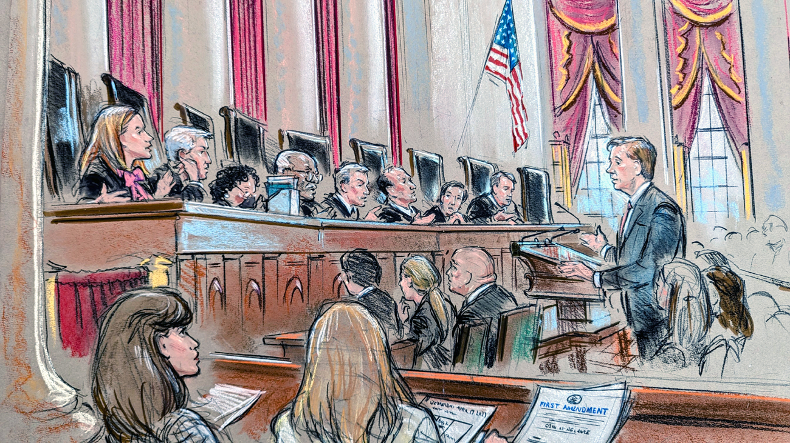
USSC case was argued last Wednesday on the Counterman case.
The case is about a Colorado man who was sentenced 4 1/2 years in prison for stalking based on the Facebook messages that he sent. At issue in the case is how courts should determine what constitutes “true threats,” which are not protected by the First Amendment.
Should the courts use the current objective test, that looks at whether a reasonable person would regard the statement as a threat of violence?
Should the courts use an subjective test, that requires the prosecution to show that the speaker intended to make the treat?
Should the courts make up a new standard?

Slide 12
What are the warning signs?
Control
Quick, intense involvement
Extreme jealousy
Isolation
Blaming others
Animal abuse

Slide 13
myths and misconceptions
Domestic violence is not very common or serious.
Domestic violence is prevalent only in low income families.
Domestic violence is a personal, family problem.
People provoke their partner’s violence.

Slide 14
Why do victims stay?
Leaving is a process, not an event
May love their batterer
Hope therapy will help
Believe the batterer will change
Financial reasons
For the children
To keep others safe

Slide 15
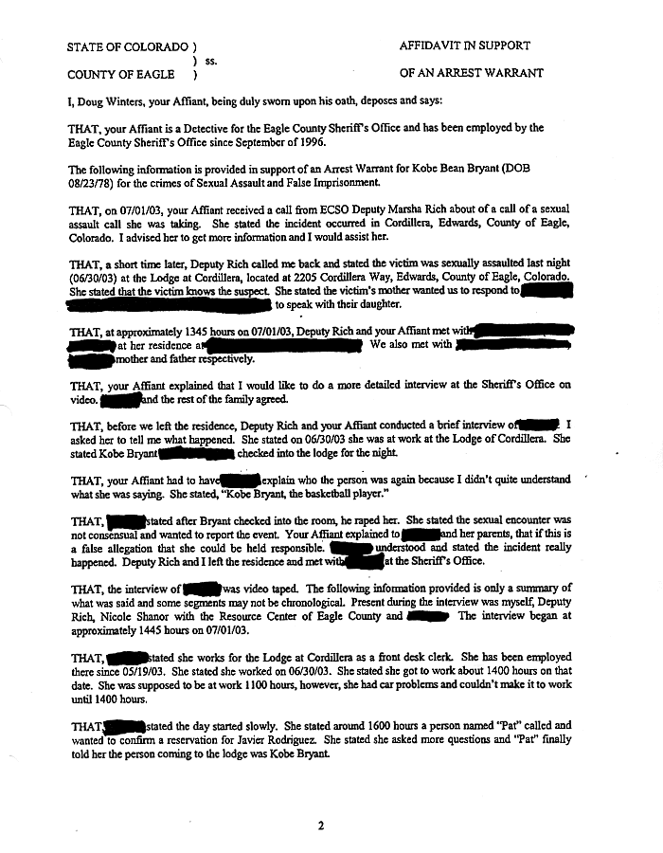
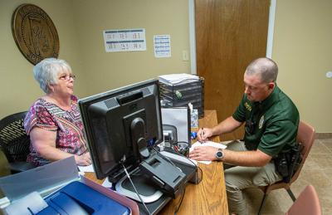
What ways do we, magistrates, based our determination on?
Affidavit
Testimony/in person

Slide 16
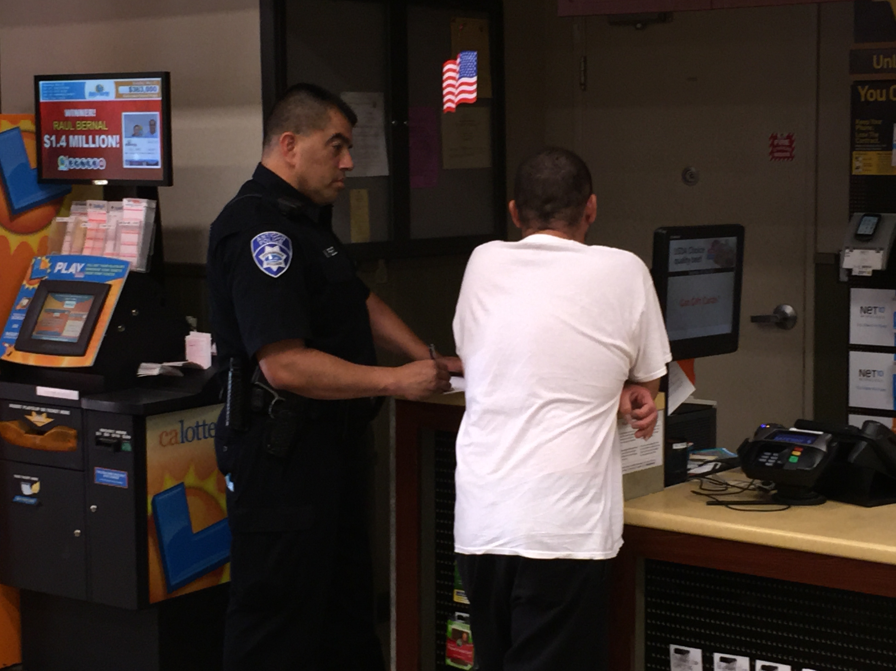
Information
Statements provided by witnesses and victims, information provided by informants, and announcements made through police bulletins and broadcasts.

Slide 17

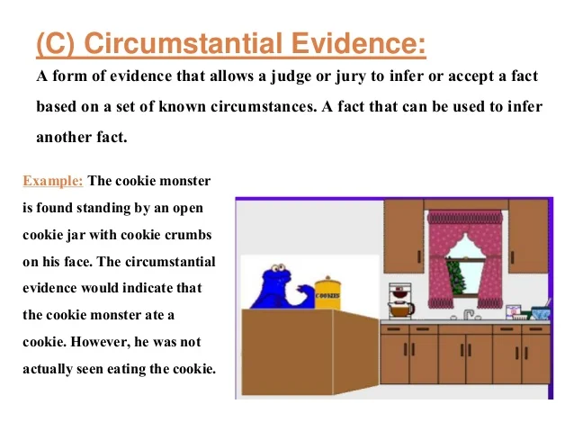
Circumstantial Evidence
This is indirect evidence that implies that a crime has occurred but does not directly prove it.

Slide 18
Civilian Affiants for Domestic Violence
Is it a good idea for law enforcement to advise persons that are possible victims of a felony or misdemeanor domestic violence incident to seek the warrant for themselves??????
Any changes for Us?
Yes…..
T.C.A. 40-6-205. Issuance of Warrant
For civilian affiants, there is a presumption that neither a warrant nor a summons will be issued for felonies under subsection (b)(3); unless
the judicial commissioner finds a warrant is necessary to prevent immediate danger to a victim of domestic violence, sexual assault, or stalking as defined in 36-3-601”, then a warrant can be issued under T.C.A. 40-6-205(b)(2)

Slide 19

Break………………

Slide 20
What is the law?
36-3-601. Part definitions
"Domestic abuse victim" means any person who falls within the following categories:
(A) Adults or minors who are current or former spouses;
(B) Adults or minors who live together or who have lived together;
(C) Adults or minors who are dating or who have dated or who have or had a sexual relationship. As used herein, "dating" and "dated" do not include fraternization between two (2) individuals in a business or social context;
(D) Adults or minors related by blood or adoption;
(E) Adults or minors who are related or were formerly related by marriage; or
(F) Adult or minor children of a person in a relationship that is described in subdivisions (5)(A)-(E);

Slide 21
Questions
Does this applied to college students who live together on campus dorms?
What if the marriage was expunged?? Does it still apply?
Does this applied to persons who live in the same home, but one lives in the basement of the house and no family relationship?
Does this applied to persons who live together in a homeless shelter? What if they share the same room?

Slide 22
"Preferred response“
TCA 36-3-619
If a law enforcement officer has probable cause to believe that a person has committed a crime involving domestic abuse, whether the crime is a misdemeanor or felony, or was committed within or without the presence of the officer, the preferred response of the officer is arrest.
(b) If a law enforcement officer has probable cause to believe that two (2) or more persons committed a misdemeanor or felony, or if two (2) or more persons make complaints to the officer, the officer shall try to determine who was the primary aggressor. Arrest is the preferred response only with respect to the primary aggressor. The officer shall presume that arrest is not the appropriate response for the person or persons who were not the primary aggressor. If the officer believes that all parties are equally responsible, the officer shall exercise such officer's best judgment in determining whether to arrest all, any or none of the parties.

Slide 23
Factors
(1) The history of domestic abuse between the parties;
(2) The relative severity of the injuries inflicted on each person;
(3) Evidence from the persons involved in the domestic abuse;
4) The likelihood of future injury to each person;
(5) Whether one (1) of the persons acted in self-defense; and
(6) Evidence from witnesses of the domestic abuse.

Slide 24
Domestic Violence Law Bond Conditions
Present law generally requires a magistrate to impose one or more of the following conditions of release or bail on a defendant who was arrested for domestic violence (or certain other offenses) to protect the alleged victim of any such offense and to ensure the appearance of the defendant at a subsequent court proceeding:
(1) An order enjoining the defendant from threatening to commit or committing specified offenses against the alleged victim;
(2) An order prohibiting the defendant from communicating with the alleged victim;
(3) An order directing the defendant to vacate or stay away from the home of the alleged victim and to stay away from any other location where the victim is likely to be;

Slide 25
Domestic Violence Law Bond Conditions
4) An order prohibiting the defendant from using or possessing a firearm or other weapon specified by the magistrate;
(5) An order prohibiting the defendant from possession or consumption of alcohol, controlled substances or controlled substance analogues;
(6) An order requiring the defendant to carry or wear a GPS monitoring device; and
(7) Any other order required to protect the safety of the alleged victim and to ensure the appearance of the defendant in court.

Slide 26
Aggravate Assault
(1) A person commits aggravated assault who:
(A) Intentionally or knowingly commits an assault as defined in § 39-13-101, and the assault:
(i) Results in serious bodily injury to another;
(ii) Results in the death of another;
(iii) Involved the use or display of a deadly weapon; or
(iv) Involved strangulation or attempted strangulation; or
(B) Recklessly commits an assault as defined in § 39-13-101(a)(1), and the assault:
(i) Results in serious bodily injury to another;
(ii) Results in the death of another; or
(iii) Involved the use or display of a deadly weapon.

Slide 27
Strangulation
( (2) For purposes of subdivision (a)(1)(A)(iv), “strangulation” means intentionally or knowingly impeding normal breathing or circulation of the blood by applying pressure to the throat or neck or by blocking the nose and mouth of another person, regardless of whether that conduct results in any visible injury or whether the person has any intent to kill or protractedly injure the victim.

Slide 28
New law for Domestic Violence as of July 1, 2022.
New law adds to the present law provisions governing bail that following the arrest of a person for the offense of aggravated assault under circumstances in which the alleged victim of the offense is a domestic abuse victim, the court or magistrate must make a finding whether there is probable cause to believe the respondent:
(A) Caused serious bodily injury to the alleged domestic abuse victim;
(B) Strangled or attempted to strangle the alleged domestic abuse victim; or
(C) Used or displayed a deadly weapon.

Slide 29
New law for Domestic Violence as of July 1, 2022.
If the court or magistrate finds probable cause to believe that one or more of the circumstances in (A)-(C) did occur, unless the court or magistrate finds the offender no longer poses a threat to the alleged victim or public safety, then the court or magistrate may, in addition to the 12-hour hold period and victim notification requirements in present law, extend the 12-hour hold period up to 24 hours after the time of arrest. Also, prior to the offender's release on bond, the court or magistrate must issue a no contact order containing all of the bond conditions set out in this section that are applicable to the protection of the domestic abuse victim.

Slide 30
Question?
If a aggravated assault suspect is arrested 7 months after the incident, would you give the suspect a 12 hour hold?
24 hour hold?
No hold?
If the warrant for aggravate assault was issued on a suspect of an aggravate assault, and victim and suspect were married 7 months after the aggravate assault incident occurred, would you issue any hold?

Slide 31
What happens if the Magistrate determines that there was not probable cause for the arrest, BUT the DV suspect has been detained by the Officer?
Has this happen to you?
What happen?

Slide 32
Ex Parte Order of Protection
TCA 36-3-305
(a) Upon the filing of a petition under this part, the courts may immediately, for good cause shown, issue an ex parte order of protection.
What is good cause??????? What is required?
Answers: immediate and present danger
How soon MUST the court date be set after service of the respondent of the Ex Parte Order??
Within fifteen (15) days of service of such order on the respondent under this part, a hearing must be held,

Slide 33
Immediate and present Danger
Example: 1
I work at Target for the last few weeks. Seven days ago, another employee asked to be my friend on Facebook. He sent me a request and I approved it. However, ever since then, he has posted nothing but videos/pictures of him diving. I’m afraid of water and it makes me freak out. I tried to block him, but he uses fake Facebook profiled and resubmit the friend request. I have granted 25 requests in the last two days and one was this employee under a new name, Scuba Steve, and he continue to post pictures and videos of him diving. I asked him to stop, but he refused.

Slide 34
Immediate and present Danger
Example: 2
I live in this county. I met a person online and we have met at his home in another state and had a sexual relationship. He has never been in this state. I stop seeing him five months ago, and he started to send me text messages that were very scary. 15 messages in which he stated that he will come to my house, once he gets out of jail for DUI, and rape me. He somehow found out where I lived. I don’t know how long he is in jail, or if he is really in jail. He sent me pictures of a 9MM handgun two weeks ago that had a caption of “you will see this soon”. I’m scared that he will come to my home and harm me. I came home today and received a text message from him asking me if I am home today? I’m in fear for my safety.

Slide 35
Immediate and present Danger
Example 3:
I have been having a horrible time with my brother, who lives next to my house in a trailer on my property. Last month, he killed three of his cats and placed the dead cats in a fire pit. He will not talk to anyone.
I went to his trailer seven days ago and he was inside with a handgun. He pointed the handgun at me and told me to get our of his trailer. He has done this in the past and I left not thinking much about it, I wasn’t afraid. That was just him being him. He thinks it is funny.
But after talking to my friend, who is an attorney, she advised me to get an order of protection since it did not matter if I was afraid of him. He still committed an Aggravated Domestic Assault.

Slide 36
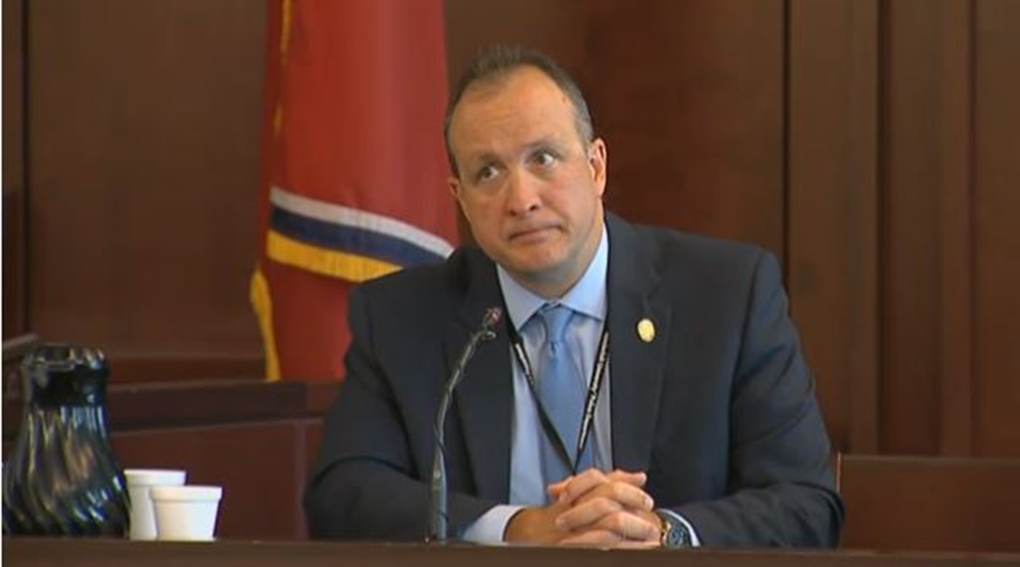
Any questions or comments?

